Slide 1
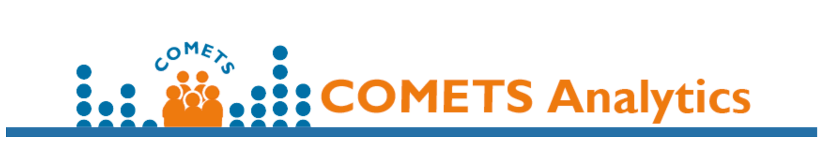
COMETS Analytics New Developments 02/11/2021
Reproducibility, usability, input/output consistency

Slide 2
COMETS Analytics Access
R Package
Web Interface
Code and Documentation
https://github.com/CBIIT/R-cometsAnalytics/tree/master/RPackageSource
Requires minimal knowledge of R/Rstudio to run. Detailed documentation on how to prepare the input and how to run through an analysis are provided.
comets-analytics.org/
User-friendly, requires no coding
Operates on secure cloud-based servers that delete data after analyses
R package
Code: https://github.com/CBIIT/R-cometsAnalytics/tree/master/RPackageSource
Vignette (for R) : https://github.com/CBIIT/R-cometsAnalytics/tree/wheelerb/RPackageSource/vignettes
(online version coming soon)
Tutorial: https://cbiit.github.io/R-cometsAnalytics/Tutorial/docs/

Slide 3
COMETS Analytics – current status
R Package
Web interface
By design, using the R package and the user interface will produce the same results!
(The GUI uses the R package exclusively)
Version 1.6 is stable and supports unadjusted and partial correlation analyses.
The next version will be a major release and will support generalized linear models, logistic regression, and proportional hazards regression, improved vignettes and documentation.
Version 1.6.2 reflects the functionality of the R package version 1.6.
Version 1.7 coming very soon
Several documentation and technical updates are underway and a revised interface will be developed with the next R package major release.

Slide 4
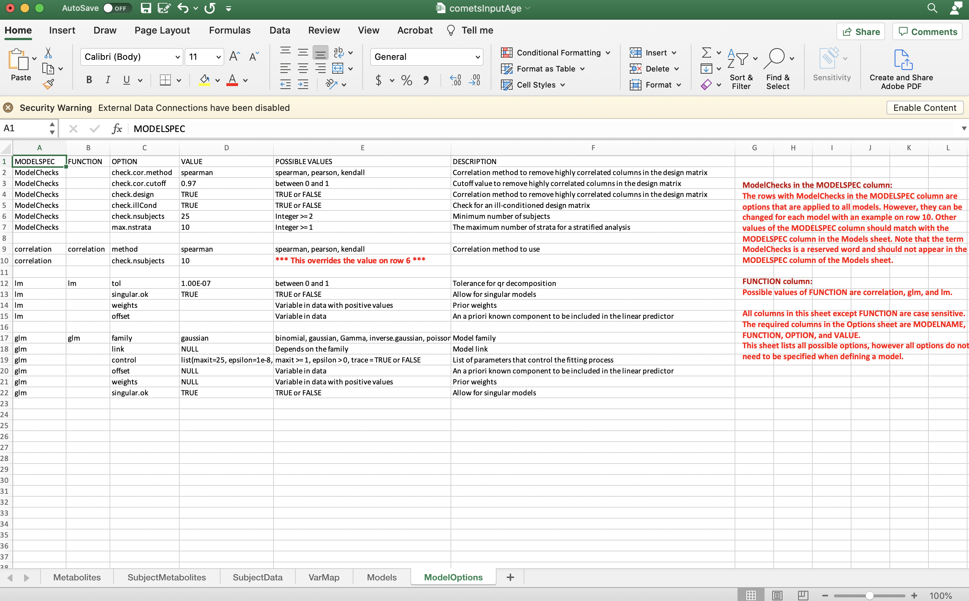
New Release Changes in Input
Metabolites: annotations
SubjectMetabolites: abundances
SubjectData: covariables
VarMap: renaming of variables
Models: tells software what models you wish to run
ModelOptions: provides flexibility for model checks and model parameters

Slide 5
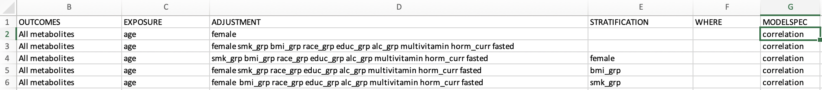
Models
New ”MODELSPEC” column: can create a specific name for the model, allowing users to change parameters for that model specifically
The name in “MODELSPEC” column for a model in this sheet then matches the name of “MODELSPEC” for rows in the ModelOptions Sheet.

Slide 6
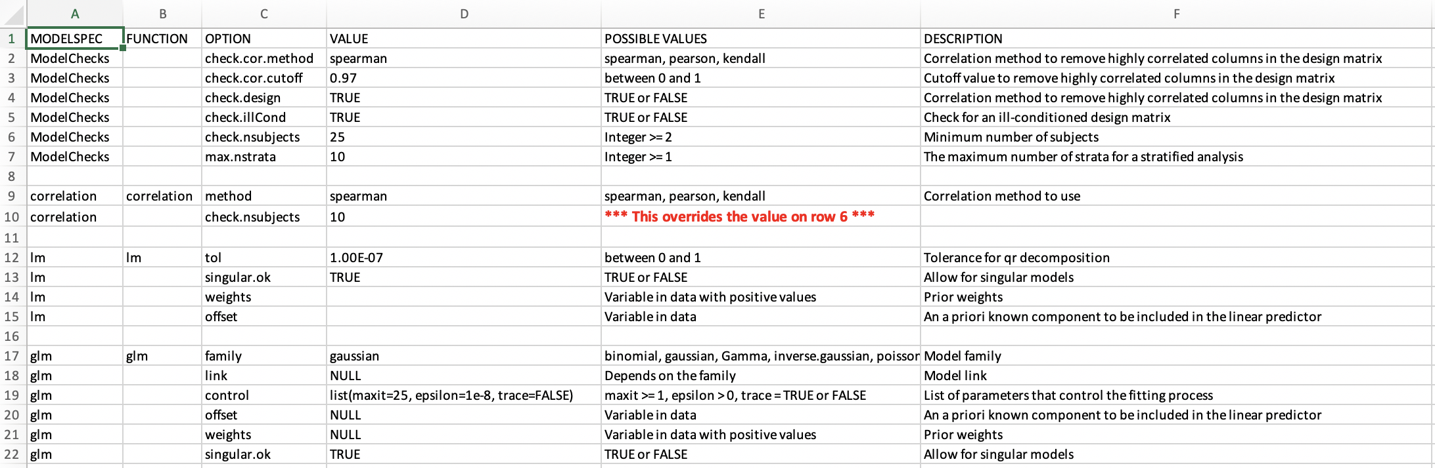
ModelOptions
New ”MODELSPEC” column: can create a specific name for the model, allowing users to change parameters for that model specifically

Slide 7
ModelOptions: ModelChecks
The rows with ModelChecks are options that are applied to all models
Default options used by the software are provided in the input file
Options can be overridden for a specific model
Note: the term ModelChecks is a reserved word and should not appear in the MODELSPEC column of the Models sheet.

Slide 8
ModelOptions: Other MODELSPEC models
FUNCTION column: Possible values are correlation, glm, and lm.
All columns in this sheet except FUNCTION are case sensitive.
MODELSPEC, FUNCTION, OPTION, and VALUE are required
Possible to override ModelCheckOptions

Slide 9
Simplified process for running models
Load Data - readCOMETSinput()
Define model – getModelData()
Interactively by specifying exposures and other criteria
By referring to a model pre-defined in the input Excel sheet
Run model – runMOdel()

Slide 10
Current Efforts
Standardized output for all models (e.g. effect size, p-value, adjusted p-value, etc.)
Fixing access to vignette
Addressing how to code missing values
Updating harmonization of metabolite names across COMETS cohorts
Updating the web interface
Addressing beta testing comments (thanks Kevin Diaz!)

Slide 11
NCATS and DPI Vision
COMETS Data Infrastructure Group
Steven Moore
Ella Temprosa
Bing Yu
Krista Zanetti
CBIIT web development Team
Kailing Chen
Brian Park
IMS
Dave Ruggieri
Bill Wheeler
Joe Zhu
Funding
EGRP/NCI
Beta Tester
Kevin Diaz
Contact us at comets.analytics@gmail.com
Join us today at our Data Infrastructure Group meeting at 1 pm!
Users! Thank you for your feedback!

